Slide 1
Chapter 9: Virtual Memory

Slide 2
Chapter 9: Virtual Memory
Page Replacement
Allocation of Frames

Slide 3
Objectives
To explain the concepts of demand paging, page-replacement algorithms, and allocation of page frames

Slide 4
Page Replacement
Page replacement completes separation between logical memory and physical memory – large virtual memory can be provided on a smaller physical memory

Slide 5
Page and Frame Replacement Algorithms
Frame-allocation algorithm determines
How many frames to give each process
Which frames to replace
Page-replacement algorithm
Want lowest page-fault rate on both first access and re-access
Evaluate algorithm by running it on a particular string of memory references (reference string) and computing the number of page faults on that string
String is just page numbers, not full addresses
Repeated access to the same page does not cause a page fault
In all our examples, the reference string is :
7,0,1,2,0,3,0,4,2,3,0,3,0,3,2,1,2,0,1,7,0,1

Slide 6
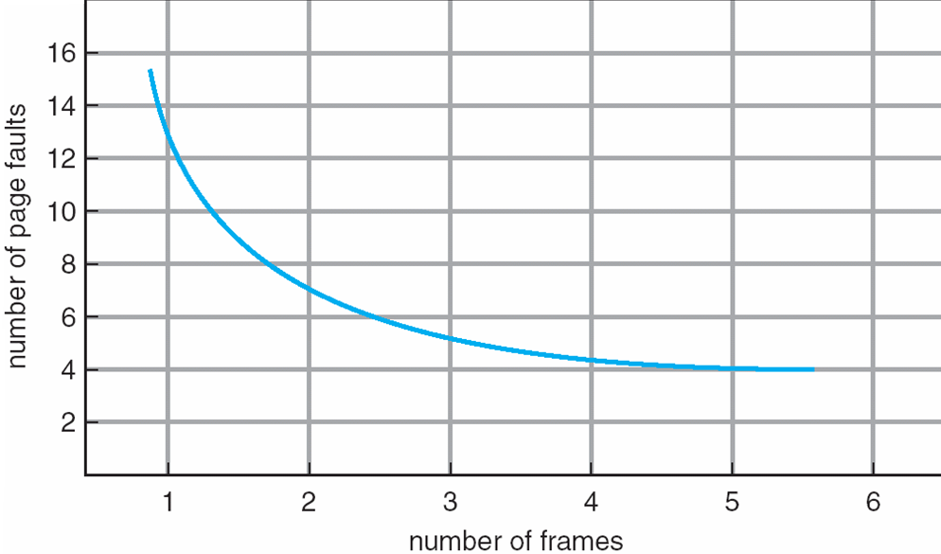
Graph of Page Faults Versus The Number of Frames

Slide 7
First-In-First-Out (FIFO) Algorithm
Reference string: 7,0,1,2,0,3,0,4,2,3,0,3,0,3,2,1,2,0,1,7,0,1
3 frames (3 pages can be in memory at a time per process)
Can vary by reference string: consider 1,2,3,4,1,2,5,1,2,3,4,5
Adding more frames can cause more page faults!
Belady’s Anomaly
How to track ages of pages?
Just use a FIFO queue
1
7
2
4 0 7
2
0
3
15 page faults
2 1 0
3
1
0
3 2 1

Slide 8
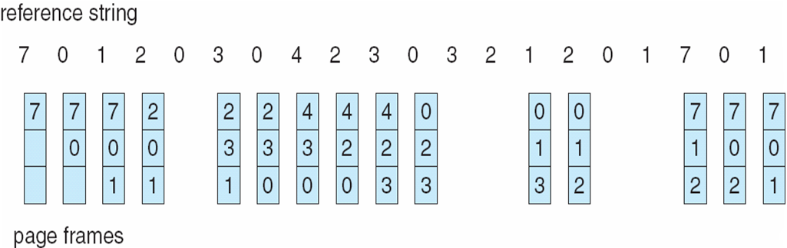
FIFO Page Replacement

Slide 9
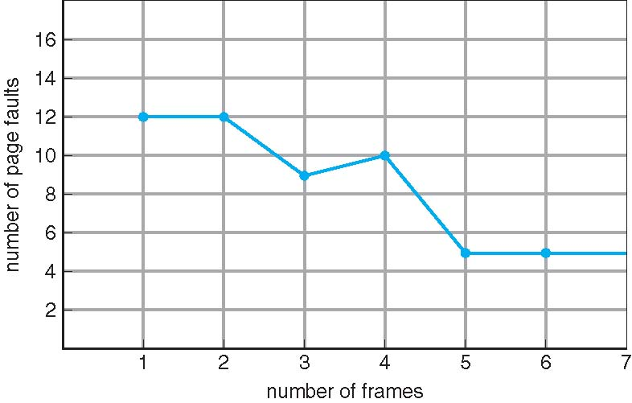
FIFO Illustrating Belady’s Anomaly

Slide 10
Optimal Algorithm
Replace page that will not be used for longest period of time
9 is optimal for the example on the next slide
How do you know this?
Can’t read the future
Used for measuring how well your algorithm performs

Slide 11
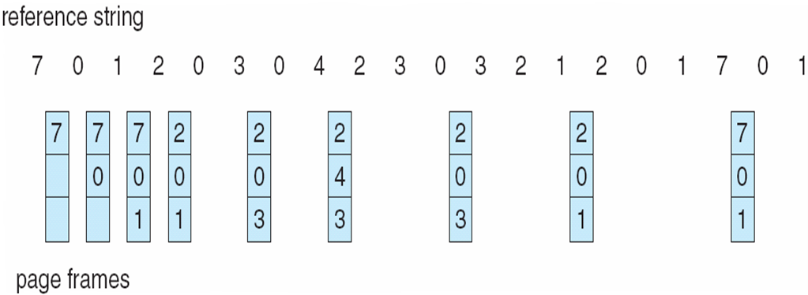
Optimal Page Replacement

Slide 12
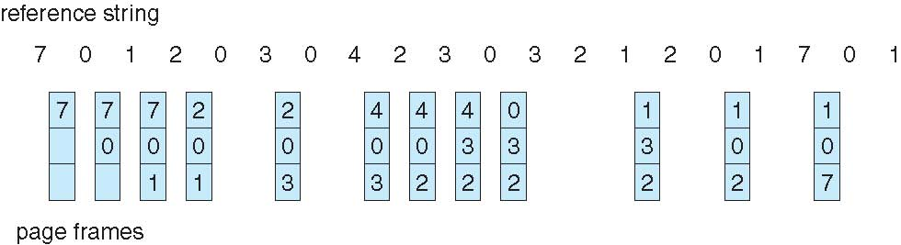
Least Recently Used (LRU) Algorithm
Use past knowledge rather than future
Replace page that has not been used in the most amount of time
Associate time of last use with each page
12 faults – better than FIFO but worse than OPT
Generally good algorithm and frequently used
But how to implement?

Slide 13
LRU Algorithm (Cont.)
Counter implementation
Every page entry has a counter; every time page is referenced through this entry, copy the clock into the counter
When a page needs to be changed, look at the counters to find smallest value
Search through table needed
Stack implementation
Keep a stack of page numbers in a double link form:
Page referenced:
move it to the top
requires 6 pointers to be changed
But each update more expensive
No search for replacement
LRU and OPT are cases of stack algorithms that don’t have Belady’s Anomaly

Slide 14
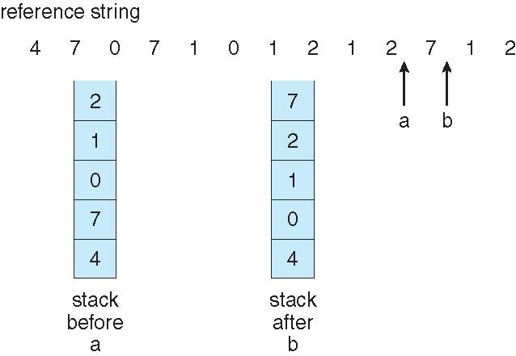
Use Of A Stack to Record The Most Recent Page References

Slide 15
LRU Approximation Algorithms
LRU needs special hardware and still slow
Reference bit
With each page associate a bit, initially = 0
When page is referenced bit set to 1
Replace any with reference bit = 0 (if one exists)
We do not know the order, however
Second-chance algorithm
Generally FIFO, plus hardware-provided reference bit
Clock replacement
If page to be replaced has
Reference bit = 0 -> replace it
reference bit = 1 then:
set reference bit 0, leave page in memory
replace next page, subject to same rules

Slide 16
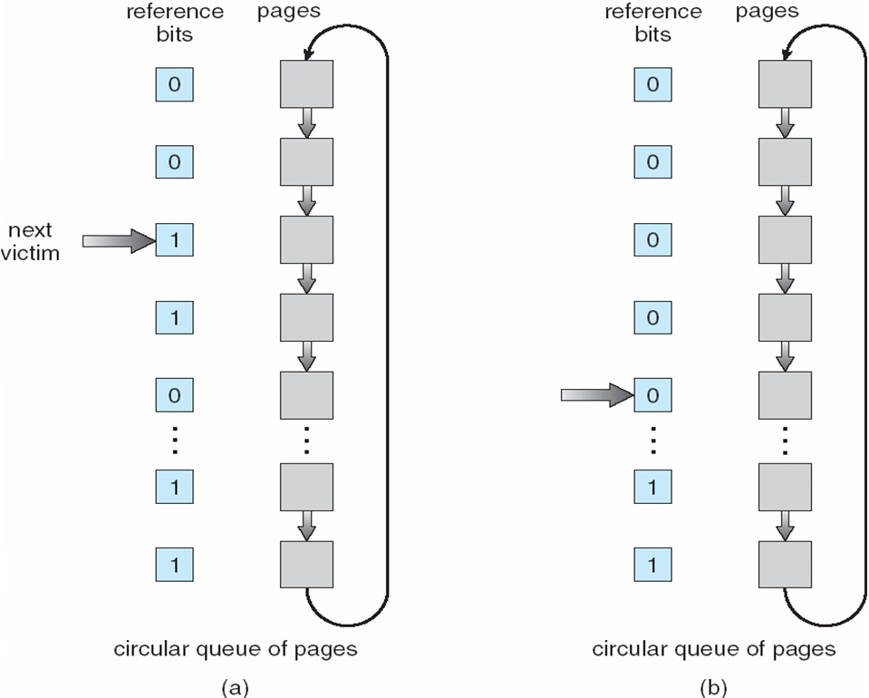
Second-Chance (clock) Page-Replacement Algorithm

Slide 17
Enhanced Second-Chance Page-Replacement Algorithm
ESCPR algorithm considers the reference bit and modify bit as an ordered pair
(0,0) neither recently used nor modified
(0,1) not recently used but modified
(1,0) recently used but not modified
(1,1) recently used and modified

Slide 18
Counting Algorithms
Keep a counter of the number of references that have been made to each page
Not common
LFU Algorithm: replaces page with smallest count
MFU Algorithm: based on the argument that the page with the smallest count was probably just brought in and has yet to be used

Slide 19
Page-Buffering Algorithms
Keep a pool of free frames, always
Then frame available when needed, not found at fault time
Read page into free frame and select victim to evict and add to free pool
When convenient, evict victim
Possibly, keep list of modified pages
When backing store otherwise idle, write pages there and set to non-dirty
Possibly, keep free frame contents intact and note what is in them
If referenced again before reused, no need to load contents again from disk
Generally useful to reduce penalty if wrong victim frame selected

Slide 20
Allocation of Frames
Each process needs minimum number of frames
Example: IBM 370 – 6 pages to handle MOVE instruction:
instruction is 6 bytes, might span 2 pages
2 pages to handle from
2 pages to handle to
Maximum of course is total frames in the system
Two major allocation schemes
fixed allocation
priority allocation
Many variations

Slide 21
Fixed & Proportional Allocation
Equal allocation – For example, if there are 100 frames (after allocating frames for the OS) and 5 processes, give each process 20 frames
Keep some as free frame buffer pool
Proportional allocation – Allocate according to the size of process
Dynamic as degree of multiprogramming, process sizes change

Slide 22
Priority Allocation
Use a proportional allocation scheme using priorities rather than size
If process P_{i} generates a page fault,
select for replacement one of its frames
select for replacement a frame from a process with lower priority number

Slide 23
Global vs. Local Allocation
Global replacement – process selects a replacement frame from the set of all frames; one process can take a frame from another
But then process execution time can vary greatly
But greater throughput so more common
Local replacement – each process selects from only its own set of allocated frames
More consistent per-process performance
But possibly underutilized memory

Slide 24
Non-Uniform Memory Access
So far all memory accessed equally
Many systems are NUMA – speed of access to memory varies
Consider system boards containing CPUs and memory, interconnected over a system bus
Optimal performance comes from allocating memory “close to” the CPU on which the thread is scheduled
And modifying the scheduler to schedule the thread on the same system board when possible
Solved by Solaris by creating lgroups
Structure to track CPU / Memory low latency groups

Slide 25
End of Chapter 9 (Part 2)

